Slide 1
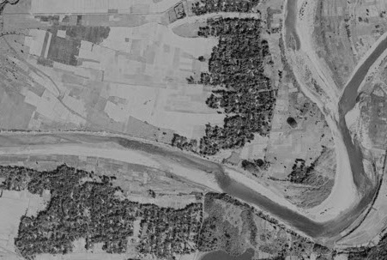
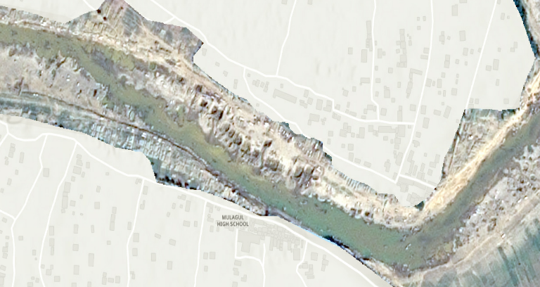
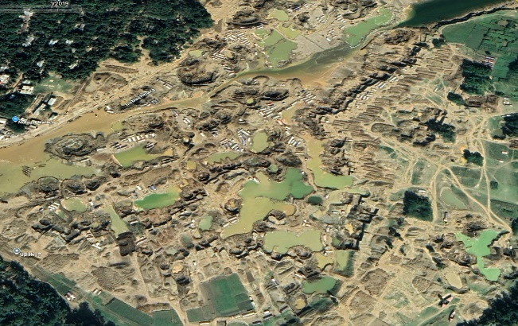
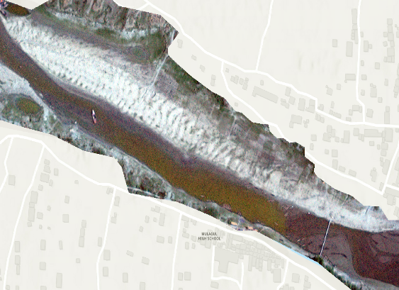

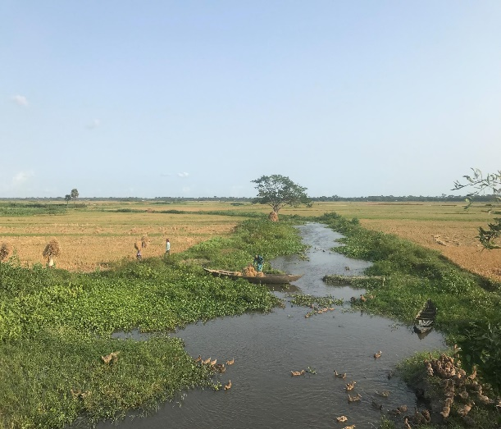
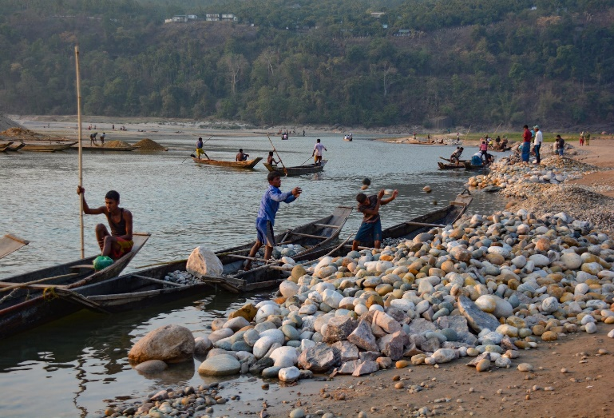
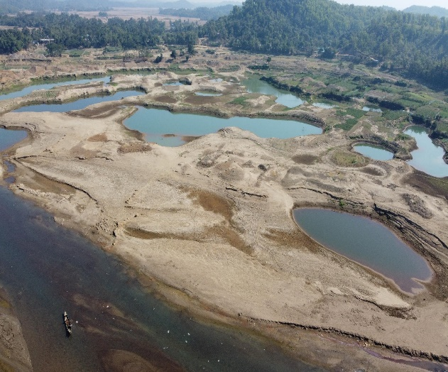
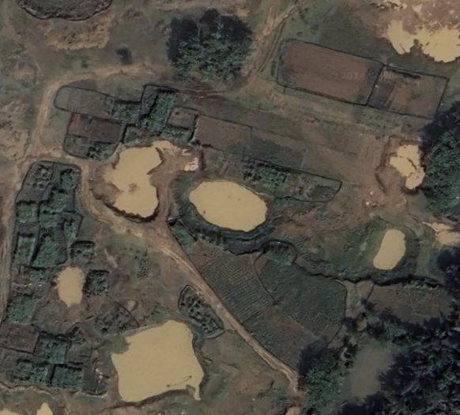
pristine riverine landscape
artisanal pit mining in river
scarred floodplain & abundant barracks
gravel dune formation
Active Channel Extraction Dominance
Abandoned Channels/Floodplain Extraction
Pre-Extraction
Recovery
Policy Guidance
1972
2012
2015
2017
2020
2021
2024
BELA Env. Impact
assessment
Mining
ban
granted
by courts
Mining
ban
enacted
Channel Extraction
Abandoned Channels/Floodplain Extraction
Migrant worker population
Gravel volume
extracted
Migrant worker
population
Time
Pristine gravel-bed river with alternate/point bars and gravel dunes in channel. Adjacent floodplain agriculture.
Small-scale artisanal mining by hand within channel. Improved income of residents, but with increasing channel degradation not replenished by yearly sediment influx. Small increase in number of temporary workers. Beginning of shift in local employment from agriculture to mining.
Large-scale mechanized extraction from floodplain, with significant increases in volume extracted and number of temporary workers. Creates economic boom, but alters aspects of social fabric, causes health concerns, degrades agricultural land and perhaps created wealth inequalities. Extraction rate unsustainable.
After enforcement of mining ban, channel morphology recovery, but with much slower change on floodplain, with floodplain ponds remaining and forming unusable areas. All temporary workers left and local economy depressed, reports of illegal smuggling to replace mining derived incomes.
Opportunity to utilize experience to guide future sustainable methods of sediment extraction.
crop fields before extraction
artisanal local labor-based mining
mechanized extraction
re-cultivation

